Slide 1

Project Brave New World
An Exploration of Robotic Scouting
and Communication Techniques in
Swarm vs. Search Party Paradigms

Slide 2
Overview
Scenario
Environment
Animat Design
Experiments
Results
Discussion

Slide 3
Scenario
Efforts for robotic exploration
Need effective techniques for exploring, assessing, and colonizing distant planets
We seek to explore the explorers by ranking various robotic scouting techniques
Efficiency (speed of finding vital resources)
Robustness (finding resources before running out of power or breaking down)
Operation in a communication and visibility inhibited environment

Slide 4
Development
StarCraft II Map Editor
Handles graphics, physics
Multi-level terrain height
Custom models
Event handlers
User interfaces
Trial tracking
Scout neural net states
Exploration stats

Slide 5
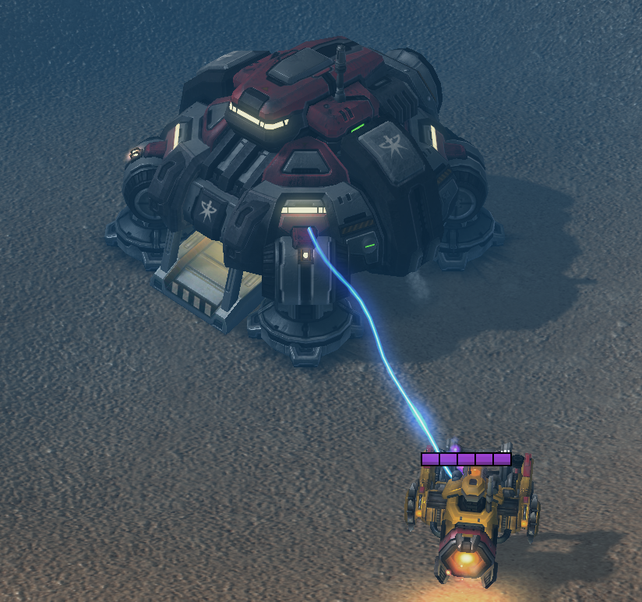
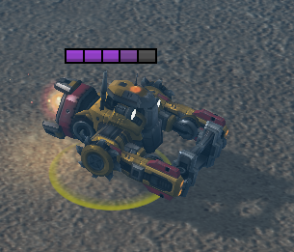
Environment
Scouts
Home Base
Charging
Central Data Storage

Slide 6
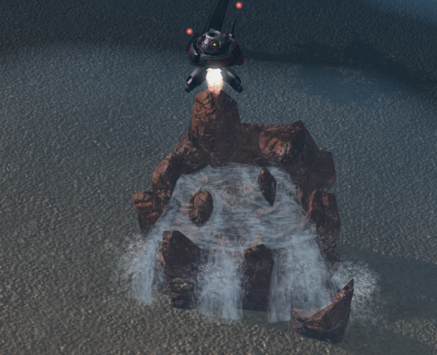
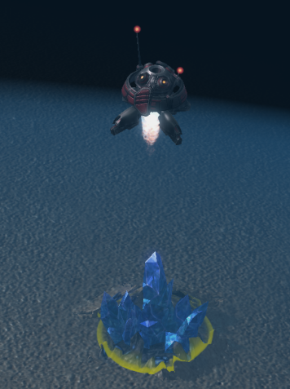
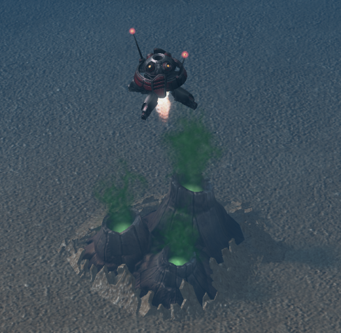
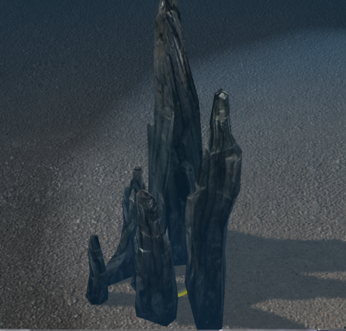
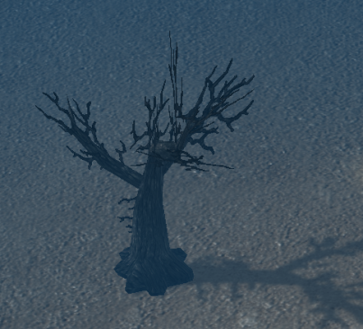
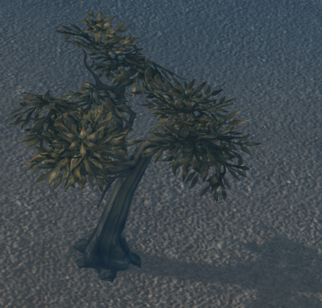
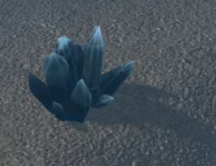
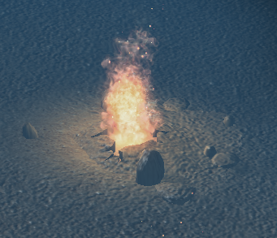
Environment
Resources and Cues
Gas, Water, Minerals
Marked Resources (top) and Cues (bottom)
Distractors

Slide 7
Animat Design
Movement
Using two thrusters to hover
Any direction
Sensors
Vision
360° camera system
Communication
Short range radio frequency

Slide 8
Animat Design
Movement Direction
Random choices (exploration)
Learned environmental cues
Group communication
Resource Marking
Resources discovered visually
Marked with beacon
Energy Depletion
Two to four units per step

Slide 9
Animat Design
Brain Structure
Neural Net

Slide 10
Animat Design
Brain Structure
Memory

Slide 11
Animat Design
Communication
Requires sufficient proximity
Each other
Home Base
Transfer learned associations
Between environmental cues and resources

Slide 12
Development Phases
Non-communicating Swarm [Control]
Scouts use Long Term Memory and Short Term Memory to create associations between resources and cues
Scouts mark found resources
Scouts return to base to charge
Scouts explore individually
No communication between scouts

Slide 13
Development Phases
Non-communicating Swarm with Location Memory
Scouts use Long Term Memory and Short Term Memory to create associations between resources and cues
Scouts mark found resources
Scouts return to base to charge
Scouts explore individually
Scouts remember their last location before going to charge
No communication between scouts

Slide 14
Experiments
All experiments consist of:
10 trials
5 minutes each
Experiment 1
Random resource discovery
Experiment 2
Neural net resource discovery
Experiment 3
Neural net resource discovery with location memory

Slide 15
Results
Experiment 1
M:
SD:
Experiment 2
M: 8.8
SD: 2.04
Experiment 3
M: 11.5
SD: 2.51

Slide 16
Future Directions
Adding communication
Adding structured search parties
Adding Home Base communication
Adding mining

Slide 17
Discussion
Difficulties
Neural net design
Weighting of Short Term Memory on Long Term Memory changes
StarCraft II Map Editor
Using Long Term Memory to influence movement direction

Slide 18
Demo

Slide 19
Andrew Forney
Ben Harounian
{benh|forns}@cs.ucla.edu
UCLA Computer Science 263C Winter 2013
Professor Michael Dyer
Tuesday March 12, 2013
Special Thanks:
Blizzard

